Slide 1
Predicate Logic
CS 236
Fall 2023

Slide 2
Overview
Topics
Proof with resolution -- brief
What is a predicate?
Universal and existential quantifiers
Assuming you won’t have read before class this week
Due
No homework due today
Project 2 due Monday
Homework 10a and 10b due Wednesday
Midterm exam available Tuesday Oct 24 – Friday Oct 27

Slide 3
Review
What is a tautology? A contradiction?
What are the two tool types we use on proofs for propositional logic?
What are the steps of doing a proof by contradiction

Slide 4
Resolution is a powerful rule of inference

Slide 5
Resolution
The Pattern
p on the first line
not p on the second
the q from the first line is or’d with the r from the second line

Slide 6
Resolution
Multiple forms

Slide 7
Resolution
Multiple forms

Slide 8
Resolution
Multiple forms

Slide 9
Resolution and proofs by contradiction

Slide 10
Resolution
We can use proof by contradiction
We negate the desired conclusion, then deduce new facts until we reach a contradiction (false)
Prove s by contradiction:
¬p∨q Premise
¬q∨s Premise
p Premise
¬s Negate the conclusion, s
¬q Resolution 2 and 4
¬p Resolution 1 and 5
F Resolution 3 and 6

Slide 11
Resolution
We can use proof by contradiction
We negate the desired conclusion, then deduce new facts until we reach a contradiction (false)
Prove s by contradiction:
¬p∨q Premise
¬q∨s Premise
p Premise
¬s Negate the conclusion, s
¬q Resolution 2 and 4
¬p Resolution 1 and 5
F Resolution 3 and 6

Slide 12
Resolution
We can use proof by contradiction with resolution
Prove s by contradiction:
¬p∨q Premise
¬q∨s Premise
p Premise
¬s Negate the conclusion, s
¬q Resolution 2 and 4
¬p Resolution 1 and 5
F Resolution 3 and 6

Slide 13
Resolution
We can use proof by contradiction with resolution
Prove s by contradiction:
¬p∨q Premise
¬q∨s Premise
p Premise
¬s Negate the conclusion, s
¬q Resolution 2 and 4
¬p Resolution 1 and 5
F Resolution 3 and 6

Slide 14
Resolution
We can use proof by contradiction with resolution
Prove s by contradiction:
¬p∨q Premise
¬q∨s Premise
p Premise
¬s Negate the conclusion, s
¬q Resolution 2 and 4
¬p Resolution 1 and 5
F Resolution 3 and 6

Slide 15
Resolution
We can use proof by contradiction with resolution
Prove s by contradiction:
¬p∨q Premise
¬q∨s Premise
p Premise
¬s Negate the conclusion, s
¬q Resolution 2 and 4
¬p Resolution 1 and 5
F Resolution 3 and 6

Slide 16
Resolution
We can use proof by contradiction with resolution
Prove s by contradiction:
¬p∨q Premise
¬q∨s Premise
p Premise
¬s Negate the conclusion, s
¬q Resolution 2 and 4
¬p Resolution 1 and 5
F Resolution 3 and 6
Therefore s by contradiction

Slide 17
Proof by Contradiction using Resolution
Instead of continuing to apply resolution aimlessly and hoping we get our desired conclusion
Algorithm
First, convert all premises to CNF (I’ll do this for you on problems you’ll see)
Second, negate the desired conclusion
Third, use resolution until contradiction is found
Fourth, state the conclusion

Slide 18
Proof by Contradiction using Resolution
Instead of continuing to apply resolution aimlessly and hoping we get our desired conclusion
Algorithm
First, convert all premises to CNF (I’ll do this for you on problems you’ll see)
Second, negate the desired conclusion
Third, use resolution until contradiction is found
Fourth, state the conclusion
If it can be proven at all
then it can be proven using this algorithm

Slide 19
Conjunctive Normal Form
All compound propositions can be written in a canonical form

Slide 20
Conjunctive Normal Form (CNF)
Rules for CNF
Propositions grouped by disjunction (∨) and separated by (∧)
Negation can only proceed a propositional variable as in ¬p

Slide 21
Conjunctive Normal Form (CNF)
Rules for CNF
Propositions grouped by disjunction (∨) and separated by (∧)
Negation can only proceed a propositional variable as in ¬p
Are the following compound propositions in CNF?
p ∨ ¬p
p ∧ (q ∨ s)
¬(q ∨ s)
(¬q ∨ s)
(p → q) ∨ (q → p)

Slide 22
Conjunctive Normal Form (CNF)
Rules for CNF
Propositions grouped by disjunction (∨) and separated by (∧)
Negation can only proceed a propositional variable as in ¬p
Are the following compound propositions in CNF?
p ∨ ¬p
p ∧ (q ∨ s)
¬(q ∨ s) (negation only at atomic level in CNF)
(¬q ∨ s)
(p → q) ∨ (q → p) (implication not allowed in CNF)
✓
✓
✗
✓
✗

Slide 23
How to convert to CNF?
Use Conditional-Disjunction Equality to remove all implications (→)
Use De Morgan’s laws to distribute in all negations (Section 1.3.2 Table 2)
Use Distributive laws to group all disjunction
Exercise: convert the following to CNF
p → q
(p → q) ∧ ¬(r ∧ ¬s)
Skipping this semester

Slide 24
Common Techniques: Resolution
Proof by resolution gives a pattern to repeat until proof is complete
Convert all premises to CNF
Apply resolution until desired conclusion is concluded
Prove ¬r using resolution
(p → q) ∧ ¬(r ∧ ¬p)
¬q
The problems we’ll give
you will already be in CNF
Notes:
Resolution helps us to automate proofs.

Slide 25
Common Techniques: Resolution
Proof by resolution gives a pattern to repeat until proof is complete
Convert all premises to CNF
Apply resolution until desired conclusion is concluded
Prove ¬r using resolution
(¬p ∨ q) ∧ (¬r ∨ p) Convert to CNF
¬q
The problems we’ll give
you will already be in CNF
Notes:
Resolution helps us to automate proofs.

Slide 26
Common Techniques: Resolution
Proof by resolution gives a pattern to repeat until proof is complete
Convert all premises to CNF
Apply resolution until desired conclusion is concluded
Prove ¬r using resolution
¬p ∨ q Premise
¬r ∨ p Premise
¬q Premise
Notes:
Resolution helps us to automate proofs.

Slide 27
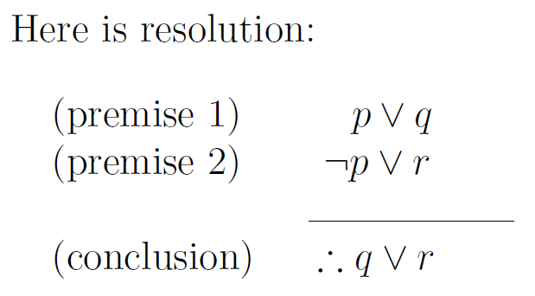
Common Techniques: Resolution
Proof by resolution gives a pattern to repeat until proof is complete
Convert all premises to CNF
Apply resolution (or disjunctive syllogism) until desired conclusion is concluded
Prove ¬r using resolution
¬p ∨ q Premise
¬r ∨ p Premise
¬q Premise
¬r ∨ q Resolution using 1 and 2
Notes:
Resolution helps us to automate proofs.

Slide 28

Common Techniques: Resolution
Proof by resolution gives a pattern to repeat until proof is complete
Convert all premises to CNF
Apply resolution (or disjunctive syllogism) until desired conclusion is concluded
Prove ¬r using resolution
¬p ∨ q Premise
¬r ∨ p Premise
¬q Premise
¬r ∨ q Resolution using 1 and 2
¬r Resolution using 3 and 4
Notes:
Resolution helps us to automate proofs.

Slide 29
Common Techniques: Resolution
Proof by resolution gives a pattern to repeat until proof is complete
Convert all premises to CNF
Apply resolution (or disjunctive syllogism) until desired conclusion is concluded
Prove ¬r using resolution
¬p ∨ q Premise
¬r ∨ p Premise
¬q Premise
¬r ∨ q Resolution using 1 and 2
¬r Resolution using 3 and 4
converted premises
concluded premises
conclusion
Notes:
Resolution helps us to automate proofs.

Slide 30
Proof by Contradiction with Resolution
Prove ¬r by contradiction using resolution
¬p ∨ q Premise
¬r ∨ p Premise
¬q Premise
r Negate desired conclusion
p Resolution with 2 and 4
q Resolution with 1 and 5
F Resolution with 3 and 6
¬r Contradiction at 7
Notes:
Resolution helps us to automate proofs.

Slide 31
Logical Operator Precedence
Precedence of Logical Operators
¬ | 1
∧ | 2
∨ | 3
⟶ | 4
⟷ | 5

Slide 32
Predicate Logic
Propositional logic is powerful, but the representation gets really big really quickly

Slide 33
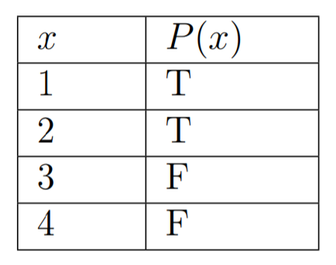
Predicates
A predicate is a parameterized propositional function
P(x), x = 1, 2, 3, 4 denotes a propositional function where P(1), P(2), P(3), P(4) each have a truth value
Propositional function is “x < 3”

Slide 34
Predicates
A predicate is a parameterized propositional function
P(x), x = 1, 2, 3, 4 denotes a propositional function where P(1), P(2), P(3), P(4) each have a truth value
Propositional function is “x < 3”
I think of a predicate as a function that takes some kind of input and returns True or False

Slide 35
Predicates
A predicate is a parameterized propositional function
P(x), x = 1, 2, 3, 4 denotes a propositional function where P(1), P(2), P(3), P(4) each have a truth value
This is not a truth table!
It is a table that defines a predicate
Propositional function is “x < 3”

Slide 36
Predicates
A predicate is a parameterized propositional function
P(x), x = 1, 2, 3, 4 denotes a propositional function where P(1), P(2), P(3), P(4) each have a truth value
The set of inputs is the domain
Propositional function is “x < 3”
I think of a predicate as a function that takes some kind of input and returns True or False

Slide 37
What is a Parser?
Datalog program
Lexer
Parser
tokens
“meaning”
(SCHEMES,"Schemes",1)
(COLON,":",1)
(ID,"snap",2)
(LEFT_PAREN,"(",2)
(ID,"S",2)
(COMMA,",",2)
(ID,"N",2)
(COMMA,",",2)
(ID,"A",2)
(COMMA,",",2)
(ID,"P",2)
(RIGHT_PAREN,")",2)
(ID,"HasSameAddress",3)
(LEFT_PAREN,"(",3)
(ID,"X",3)
(COMMA,",",3)
(ID,"Y",3)
(RIGHT_PAREN,")",3)
(FACTS,"Facts",5)
(COLON,":",5)
(ID,"snap",6)
(LEFT_PAREN,"(",6)
(STRING,"'12345'",6)
(COMMA,",",6)
(STRING,"'C. Brown'",6)
(COMMA,",",6)
(STRING,"'12 Apple'",6)
(COMMA,",",6)
(STRING,"'555-1234'",6)
(RIGHT_PAREN,")",6)
(PERIOD,".",6)
(ID,"snap",7)
(LEFT_PAREN,"(",7)
(STRING,"'333333'",7)
(COMMA,",",7)
(STRING,"'Snoopy'",7)
(COMMA,",",7)
(STRING,"'12 Apple'",7)
(COMMA,",",7)
(STRING,"'555-1234'",7)
(RIGHT_PAREN,")",7)
(PERIOD,".",7)
(RULES,"Rules",9)
(COLON,":",9)
(ID,"HasSameAddress",10)
(LEFT_PAREN,"(",10)
(ID,"X",10)
(COMMA,",",10)
(ID,"Y",10)
(RIGHT_PAREN,")",10)
(COLON_DASH,":-",10)
(ID,"snap",10)
(LEFT_PAREN,"(",10)
(ID,"A",10)
(COMMA,",",10)
(ID,"X",10)
(COMMA,",",10)
(ID,"B",10)
(COMMA,",",10)
(ID,"C",10)
(RIGHT_PAREN,")",10)
(COMMA,",",10)
(ID,"snap",10)
(LEFT_PAREN,"(",10)
(ID,"D",10)
(COMMA,",",10)
(ID,"Y",10)
(COMMA,",",10)
(ID,"B",10)
(COMMA,",",10)
(ID,"E",10)
(RIGHT_PAREN,")",10)
(PERIOD,".",10)
(QUERIES,"Queries",12)
(COLON,":",12)
(ID,"HasSameAddress",13)
(LEFT_PAREN,"(",13)
(STRING,"'Snoopy'",13)
(COMMA,",",13)
(ID,"Who",13)
(RIGHT_PAREN,")",13)
(Q_MARK,"?",13)
(EOF,"",14)
Success!
Schemes(2):
snap(S,N,A,P)
HasSameAddress(X,Y)
Facts(2):
snap('12345','C. Brown','12 Apple','555-1234').
snap('333333','Snoopy','12 Apple','555-1234').
Rules(1):
HasSameAddress(X,Y) :- snap(A,X,B,C),snap(D,Y,B,E).
Queries(1):
HasSameAddress('Snoopy',Who)?
Domain(6):
'12 Apple'
'12345'
'333333'
'555-1234'
'C. Brown'
'Snoopy'
Schemes:
snap(S,N,A,P)
HasSameAddress(X,Y)
Facts:
snap('12345','C. Brown','12 Apple','555-1234’).
snap('333333','Snoopy','12 Apple','555-1234’).
Rules:
HasSameAddress(X,Y) :- snap(A,X,B,C),snap(D,Y,B,E).
Queries:
HasSameAddress('Snoopy',Who)?
The set of inputs is the domain

Slide 38
Predicates
A predicate is a parameterized propositional function
P(x), x = 1, 2, 3, 4 denotes a propositional function where P(1), P(2), P(3), P(4) each have a truth value
We need to know
Predicate name
Predicate domain
Values for which predicate is true

Slide 39
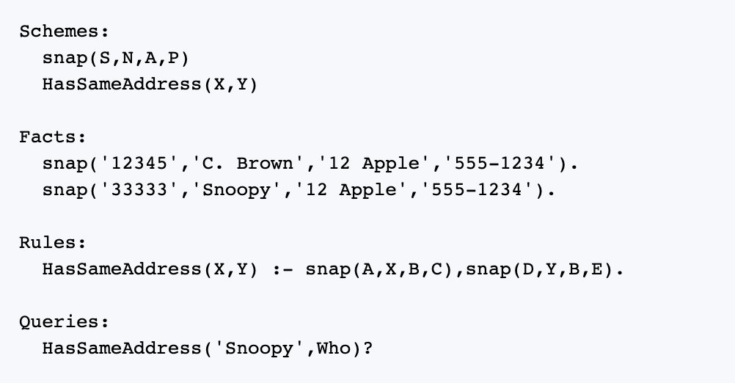
Predicates in Datalog
Predicate name
Predicate domain
Values for which predicate is true
A predicate is a parameterized propositional function
snap and HasSameAddress are both predicates

Slide 40
Predicates
Predicate name
Predicate domain
Values for which predicate is true
A predicate is a parameterized propositional function
snap and HasSameAddress are both predicates
”[Predicates] are neither true nor false when the values of the variables are not specified”. §1.4.2

Slide 41
Predicates
Predicate name
Predicate domain
Values for which predicate is true
A predicate is a parameterized propositional function
snap and HasSameAddress are both predicates
Schemes is the function
declaration section of a Datalog program

Slide 42
Predicates
Predicate name
Predicate domain
Values for which predicate is true
A predicate is a parameterized propositional function
snap and HasSameAddress are both predicates
Schemes is the function
predicate declaration section of a Datalog program

Slide 43
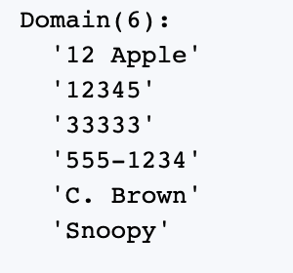
Predicates
Predicate name
Predicate domain
Values for which predicate is true
A predicate is a parameterized propositional function
The domain is the set of possible inputs to a predicate

Slide 44
Predicates
Predicate name
Predicate domain
Values for which predicate is true
A predicate is a parameterized propositional function
Facts section: elements of the domain for which are the predicates are true
= True
= True

Slide 45
Predicates
Predicate name
Predicate domain
Values for which predicate is true
A predicate is a parameterized propositional function
Rules section: gives other things I know about the world … more later
= True
= True

Slide 46
Predicates
Predicate name
Predicate domain
Values for which predicate is true
A predicate is a parameterized propositional function
Facts and Rules sections: the premises to use in proofs
= True
= True

Slide 47
Predicates
Predicate name
Predicate domain
Values for which predicate is true
A predicate is a parameterized propositional function
Queries section: the thing I want to prove
= True
= True

Slide 48
Predicate logic adds two new operators
In addition to and, or, not, implies, and bi-implication

Slide 49
Universal Quantification
The universal quantifier (∀) allows us to make a statement about all possible elements of the predicate’s domain
∀x P(x) is the proposition that states for all values of x, P(x) is true

Slide 50
Universal Quantification
Photo Op
The universal quantifier (∀) allows us to make a statement about all possible elements of the predicate’s domain
∀x P(x) is the proposition that states for all values of x, P(x) is true
We can think of the statement “∀x P(x)” as a “big AND” statement
∀x P(x)= P(x₁) ∧ P(x₂) ∧ … ∧ P(x_{n})
Notes:
For all x can only be true if it is true for all x in the domain

Slide 51
Universal Quantification
The universal quantifier (∀) allows us to make a statement about all possible elements of the predicate’s domain
Given the table for P(x), what is the truth value for ∀x P(x)?
Given a domain and a list of Facts (or premises), we can evaluate whether the claim “∀x P(x)?” is true or false
Notes:
The highlighted text is a claim or an assertion. It is a like a compound proposition, so it makes an assertion about a world.

Slide 52
Universal Quantification
The universal quantifier (∀) allows us to make a statement about all possible elements of the predicate’s domain
Given the table for P(x), what is the truth value for ∀x P(x)?
Given a domain and a list of Facts (or premises), we can evaluate whether the claim “∀x P(x)?” is true or false
When the homework asks you something like “evaluate the following expression”, it means to determine whether the compound statement is true or false

Slide 53
Universal Quantification
The universal quantifier (∀) allows us to make a statement about all possible elements of the predicate’s domain
Given the table for P(x), what is the truth value for ∀x P(x)?
False!
The counterexamples are x = 3, 4

Slide 54
Universal Quantification in Datalog
means
∀X,Y,A,B,C,D,E [snap(A,X,B,C) ∧ snap(D,Y,B,E) → HasSameAddress(X,Y)]

Slide 55
Universal Quantification in Datalog
means
∀X,Y,A,B,C,D,E [snap(A,X,B,C) ∧ snap(D,Y,B,E) → HasSameAddress(X,Y)]

Slide 56
Universal Quantification in Datalog
means
∀X,Y,A,B,C,D,E [snap(A,X,B,C) ∧ snap(D,Y,B,E) → HasSameAddress(X,Y)]

Slide 57
Predicates
Predicate name
Predicate domain
Values for which predicate is true
A predicate is a parameterized propositional function
Facts and Rules =
premises to use in proofs
= True
= True
∀X,Y,A,B,C,D,E [snap(A,X,B,C) ∧ snap(D,Y,B,E) → HasSameAddress(X,Y)]

Slide 58
Existential Quantification
The existential quantifier (∃) allows us to make a statement about all possible elements of the predicate’s domain
∃x P(x) is the proposition that states for some value x, P(x) is true

Slide 59
Existential Quantification
Photo Op
The existential quantifier (∃) allows us to make a statement about all possible elements of the predicate’s domain
∃x P(x) is the proposition that states for some value x, P(x) is true
We can think of the statement “∃ x P(x)” as a “big OR” statement
∃x P(x)= P(x₁) ∨ P(x₂) ∨ … ∨ P(x_{n})
Notes:
There exists x is true if it is true for any x in the domain. It is only false if it is false for all x in the domain

Slide 60
Existential Quantification
The existential quantifier (∃) allows us to make a statement about all possible elements of the predicate’s domain
Given the table for P(x), what is the truth value for ∃x P(x)?
Given a domain and a list of Facts (or premises), we can evaluate whether the claim “∃ x P(x)?” is true or false

Slide 61
Existential Quantification
The existential quantifier (∃) allows us to make a statement about all possible elements of the predicate’s domain
Given the table for P(x), what is the truth value for ∃x P(x)?
True!
Where x = 1, or 2

Slide 62
Practice
Define P(x) so that ∀x P(x) = true
Define Q(x) so that ∃ x Q(x) = true

Slide 63
Practice
Define P(x) so that ∀x P(x) = true
Define Q(x) so that ∃ x Q(x) = true
True for all x
T
T
T
T

Slide 64
Practice
Define P(x) so that ∀x P(x) = true
Define Q(x) so that ∃ x Q(x) = true
True for at least one x.
This definition works.
T
T
T
F
T
F
T
F

Slide 65
Practice
Define P(x) so that ∀x P(x) = true
Define Q(x) so that ∃ x Q(x) = true
True for at least one x.
So does this one
T
T
T
T
T
F
T
F

Slide 66
Practice
Define P(x) so that ∀x P(x) = true
Define Q(x) so that ∃ x Q(x) = true
True for at least one x.
and this one
T
F
T
T
T
F
T
F

Slide 67
Practice
∀a,b,c,d snap(a,b,c,d) = ?
∃ a,b,c,d snap(a,b,c,d) = ?
∀d snap(‘33333’,’Snoopy’,’12 Apple’,d) = ?
∃ d snap(‘33333’,’Snoopy’,’12 Apple’,d) = ?

Slide 68
Practice
∀a,b,c,d snap(a,b,c,d) = F
∃ a,b,c,d snap(a,b,c,d) = T
∀d snap(‘33333’,’Snoopy’,’12 Apple’,d) = F
∃ d snap(‘33333’,’Snoopy’,’12 Apple’,d) = T

Slide 69
Quantification Precedence
Precedence
∀,∃ | 0
¬ | 1
∧ | 2
∨ | 3
⟶ | 4
⟷ | 5

Slide 70
Quantification Precedence
Precedence
∀,∃ | 0
¬ | 1
∧ | 2
∨ | 3
⟶ | 4
⟷ | 5
Universal (∀) and existential (∃) quantification have higher precedence than any other logical operator (¬, ∨, ∧, →, …)
¬∀x P(x)means ¬(∀x P(x))
∀x ¬P(x)means ∀x (¬P(x))
∀x P(x) → Q(x,y) means (∀x P(x)) → Q(x,y)

Slide 71
Quantifier Scope

Slide 72
Quantifier Scope
int i = 37; std::cout << "In the loop scope:\n"; for (int i = 0; i<5; i++) std::cout << "\ti = " << i << "\n"; std::cout << "Out of the loop scope: i = " << i << "\n";

Slide 73
Quantifier Scope
In the loop scope:
i = 0
i = 1
i = 2
i = 3
i = 4
Out of the loop scope: i = 37
int i = 37; std::cout << "In the loop scope:\n"; for (int i = 0; i<5; i++) std::cout << "\ti = " << i << "\n"; std::cout << "Out of the loop scope: i = " << i << "\n";

Slide 74
Quantifier Scope
In the loop scope:
i = 0
i = 1
i = 2
i = 3
i = 4
Out of the loop scope: i = 37
int i = 37; std::cout << "In the loop scope:\n"; for (int i = 0; i<5; i++) std::cout << "\ti = " << i << "\n"; std::cout << "Out of the loop scope: i = " << i << "\n";
Don’t do this – it’s bad coding style

Slide 75
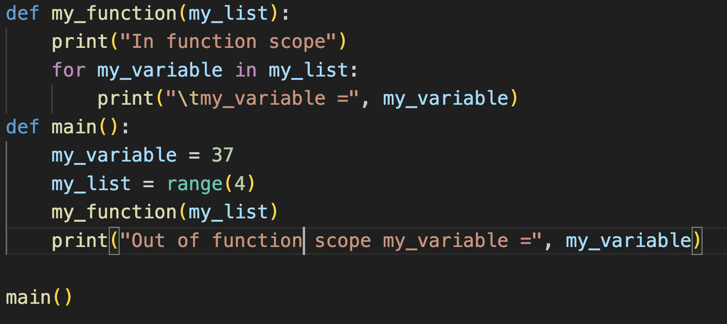
Quantifier Scope
In function scope
my_variable = 0
my_variable = 1
my_variable = 2
my_variable = 3
Out of function scope my_variable = 37

Slide 76
Quantifier Scope
A variable is said to be bound when it is used with a quantifier

Slide 77
Quantifier Scope
A variable is said to be bound when it is used with a quantifier
A variable without a quantifier is free

Slide 78
Quantifier Scope
Precedence
∀,∃ | 0
¬ | 1
∧ | 2
∨ | 3
⟶ | 4
⟷ | 5
A variable is said to be bound when it is used with a quantifier
A variable without a quantifier is free
Determine which of the following variables are bound or free:

Slide 79
Quantifier Scope
Precedence
∀,∃ | 0
¬ | 1
∧ | 2
∨ | 3
⟶ | 4
⟷ | 5
A variable is said to be bound when it is used with a quantifier
A variable without a quantifier is free
Determine which of the following variables are bound or free:
bound

Slide 80
Quantifier Scope
A variable is said to be bound when it is used with a quantifier
A variable without a quantifier is free
Determine which of the following variables are bound or free:
bound
free

Slide 81
Quantifier Scope
A variable is said to be bound when it is used with a quantifier
A variable without a quantifier is free
Determine which of the following variables are bound or free:
bound
free
from the scope of the forall loop

Slide 82
Quantifier Scope
A variable is said to be bound when it is used with a quantifier
A variable without a quantifier is free
Determine which of the following variables are bound or free:
In effect, these x’s are completely different variables that just happen to have the same name
bound
free

Slide 83
Quantifier Scope
A variable is said to be bound when it is used with a quantifier
A variable without a quantifier is free
Determine which of the following variables are bound or free:
The scope of the quantifier is the part of the logical expression to which the quantifier applies
scope of ∀x

Slide 84
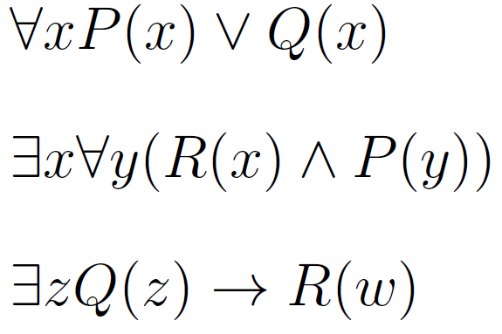
Quantifier Scope
Precedence
∀,∃ | 0
¬ | 1
∧ | 2
∨ | 3
⟶ | 4
⟷ | 5
A variable is said to be bound when it is used with a quantifier
A variable without a quantifier is free
Determine which of the following variables are bound or free:

Slide 85
Quantifier Scope
Precedence
∀,∃ | 0
¬ | 1
∧ | 2
∨ | 3
⟶ | 4
⟷ | 5
A variable is said to be bound when it is used with a quantifier
A variable without a quantifier is free
Determine which of the following variables are bound or free:
Variables x and w are free because they are not set with a quantifier

Slide 86
Quantifier Scope
Precedence
∀,∃ | 0
¬ | 1
∧ | 2
∨ | 3
⟶ | 4
⟷ | 5
A variable is said to be bound when it is used with a quantifier
A variable without a quantifier is free
Determine which of the following variables are bound or free:
These variables are all bound to a quantifier (note binding within parentheses)

Slide 87
Quantifier Scope
Precedence
∀,∃ | 0
¬ | 1
∧ | 2
∨ | 3
⟶ | 4
⟷ | 5
A variable is said to be bound when it is used with a quantifier
A variable without a quantifier is free
Determine which of the following variables are bound or free:
scope of ∀y

Slide 88
Quantifier Scope
Precedence
∀,∃ | 0
¬ | 1
∧ | 2
∨ | 3
⟶ | 4
⟷ | 5
A variable is said to be bound when it is used with a quantifier
A variable without a quantifier is free
Determine which of the following variables are bound or free:
scope of ∃x

